Slide 1
LINTUL-CassavaNPK
Modelling NPK limitations

Slide 2
LINTUL-Cassava
RUE based
Tabulated partitioning
PENMAN-based evapotranspiration

Slide 3
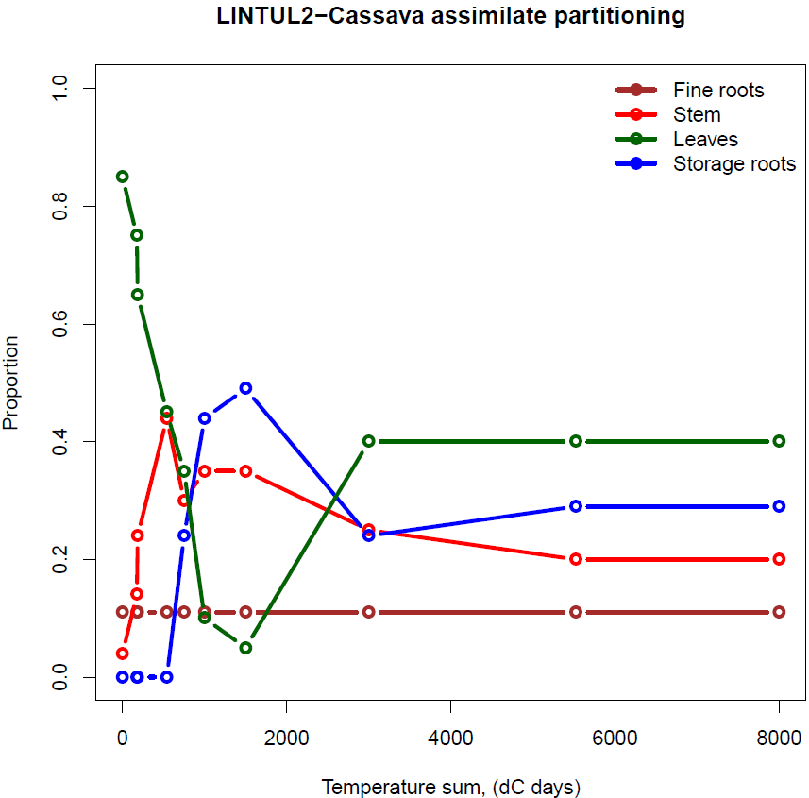
Tabulated assimilate partitioning

Slide 4
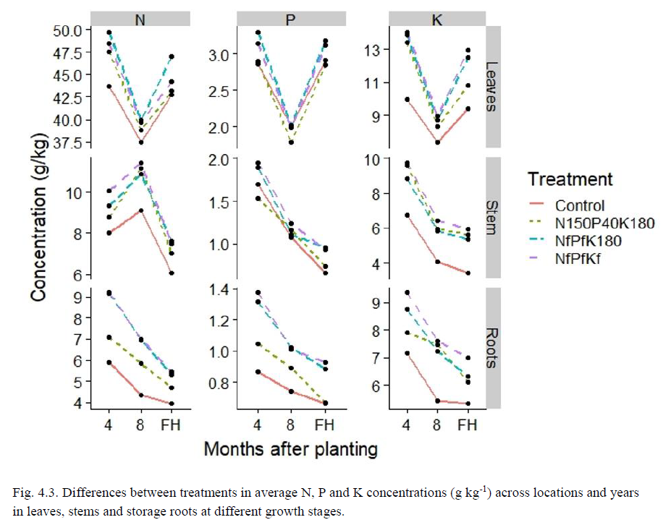
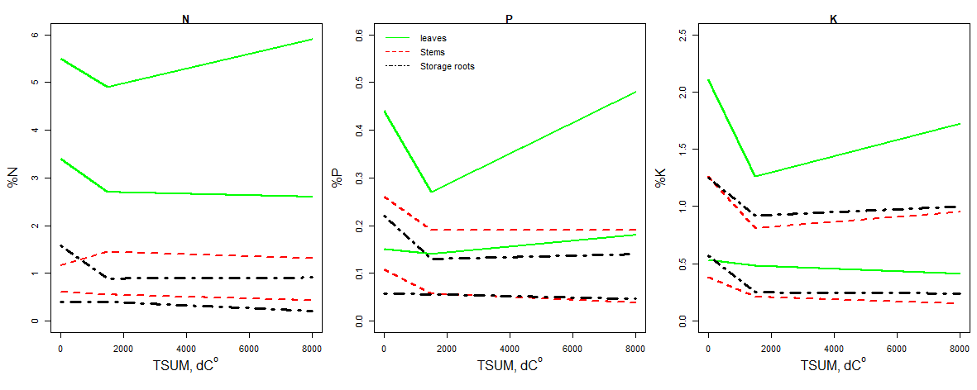
Nutrient concentrations in Cassava organs

Slide 5
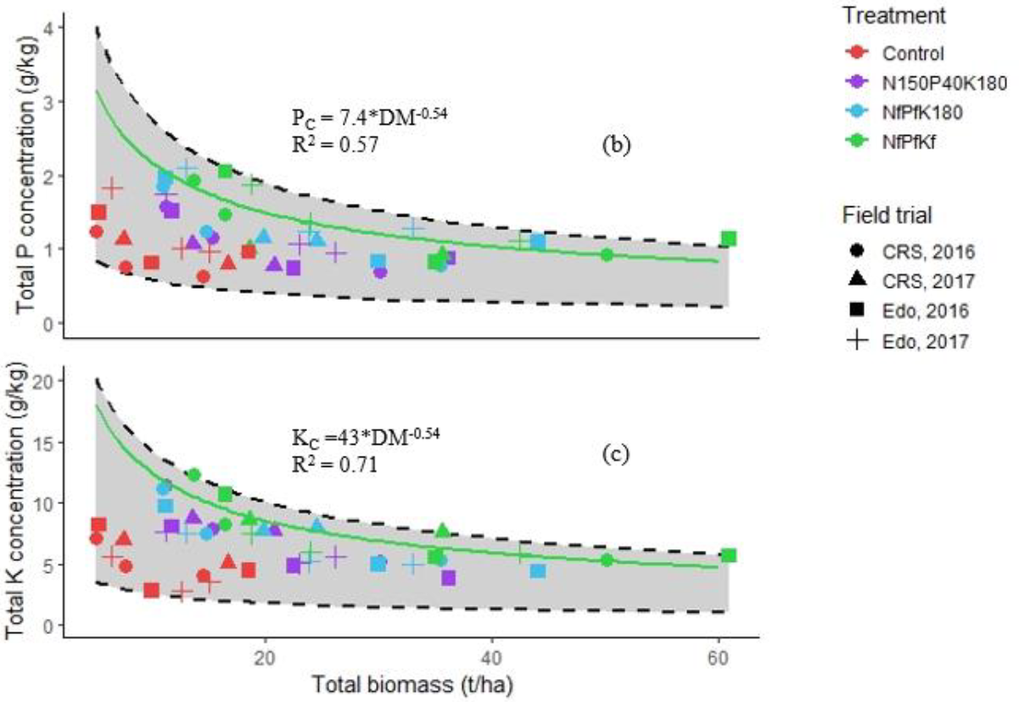
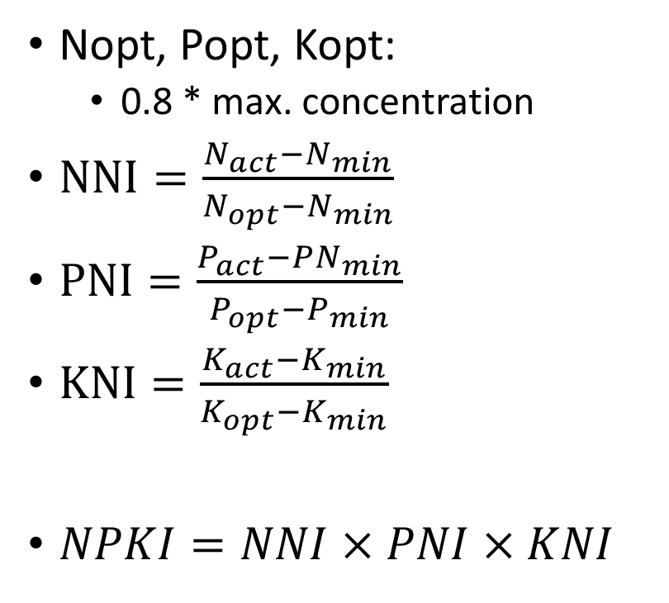
Nutrition indices
Nopt, Popt, Kopt:
  0.8 * max. concentration
$NNI=\frac{N_{act}−N_{min}}{N_{opt}−N_{min}}$
$PNI=\frac{P_{act}−PN_{min}}{P_{opt}−P_{min}}$
$KNI=\frac{K_{act}−K_{min}}{K_{opt}−K_{min}}$
$NPKI=NNI×PNI×KNI$

Slide 6
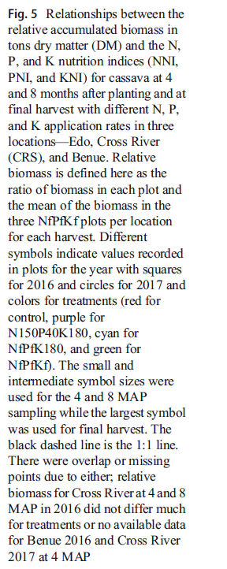
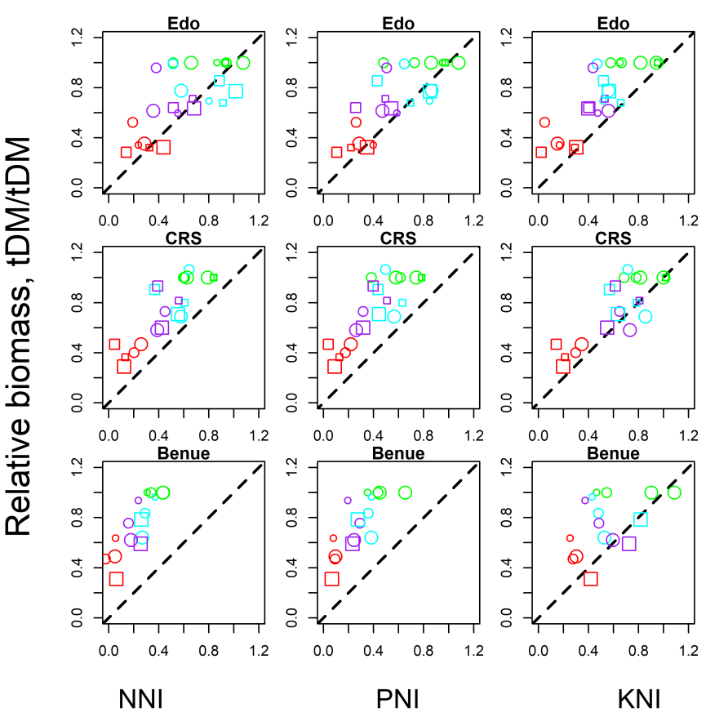
Nutrition indices explain growth rate reduction
Adiele et al. 2021. Dynamics of N-P-K demand and uptake in cassava.
Agr. Sust.Dev.

Slide 7
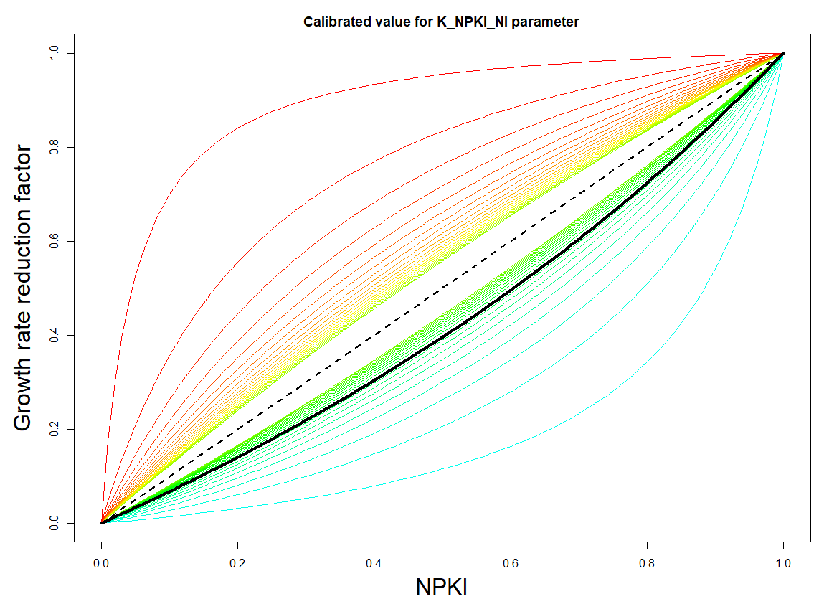
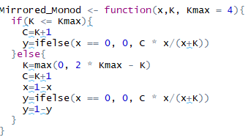
Growth rate reduction due to N, P and K limitations
“Mirrored Monod”
Calibrated K value

Slide 8
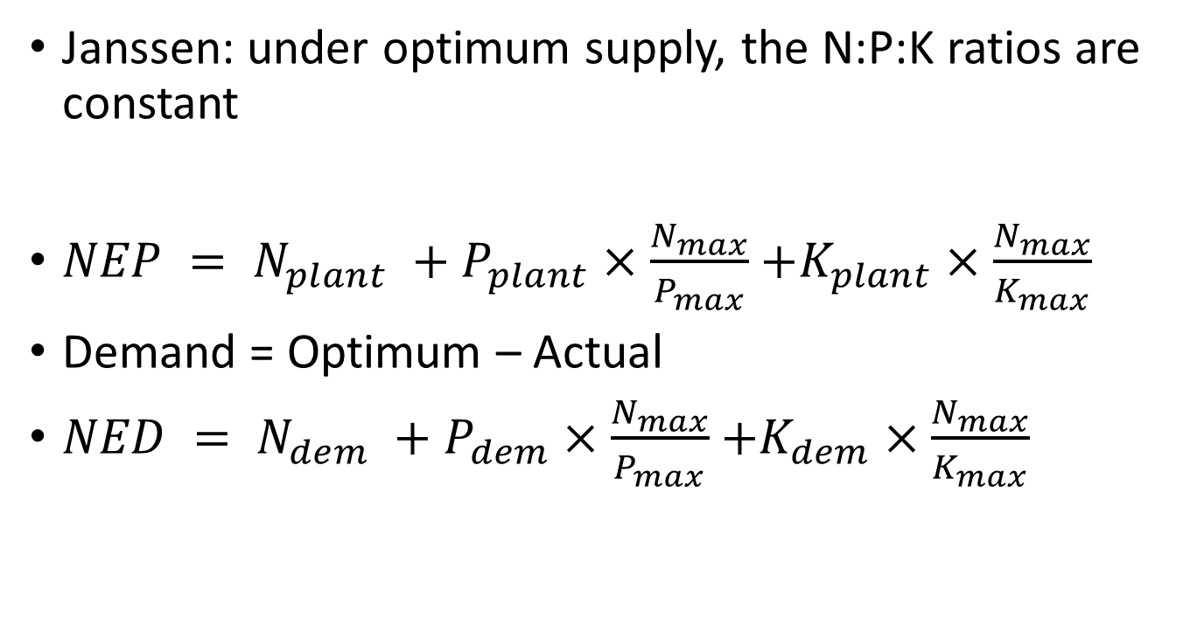
Nutrient equivalents: demand
Janssen: under optimum supply, the N:P:K ratios are constant
$NEP = N_{plant} +P_{plant}×\frac{N_{max}}{P_{max}}$ $+K_{plant}×\frac{N_{max}}{K_{max}}$
Demand = Optimum – Actual
$NED = N_{dem} +P_{dem}×\frac{N_{max}}{P_{max}}$ $+K_{dem}×\frac{N_{max}}{K_{max}}$

Slide 9
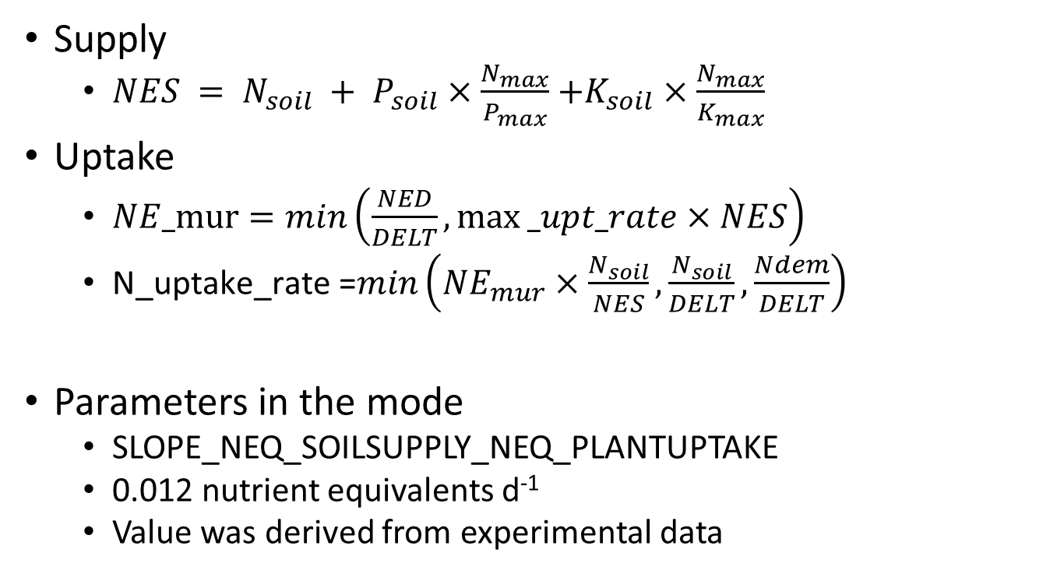
Nutrient equivalents: supply and uptake
Supply
  $NES = N_{soil} + P_{soil}×\frac{N_{max}}{P_{max}}$ $+K_{soil}×\frac{N_{max}}{K_{max}}$
Uptake
  $NE_mur=min\left(\frac{NED}{DELT},max⁡_upt_rate×NES\right)$
  $\text{N}\text{_}\text{uptake}\text{_}\text{rate}\text{ =}min\left(NE_{mur}×\frac{N_{soil}}{NES},\frac{N_{soil}}{DELT},\frac{Ndem}{DELT}\right)$
Parameters in the mode
  SLOPE_NEQ_SOILSUPPLY_NEQ_PLANTUPTAKE
  0.012 nutrient equivalents d⁻¹
  Value was derived from experimental data

Slide 10
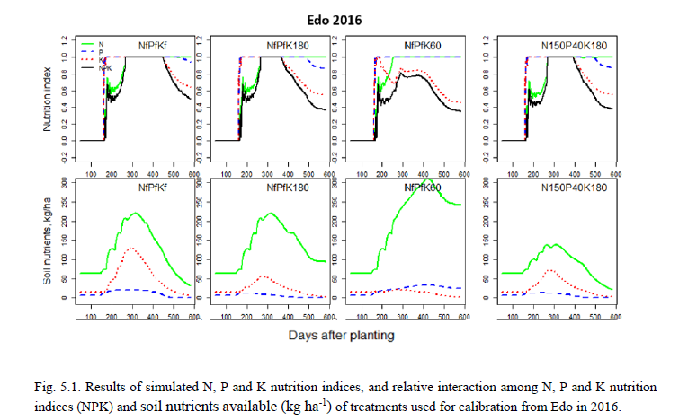
Evaluation of nutrient limitations
Full NPK supply:
Cross river
  N limited
Edo:
  K limited
Benue
  Water limited

Slide 11
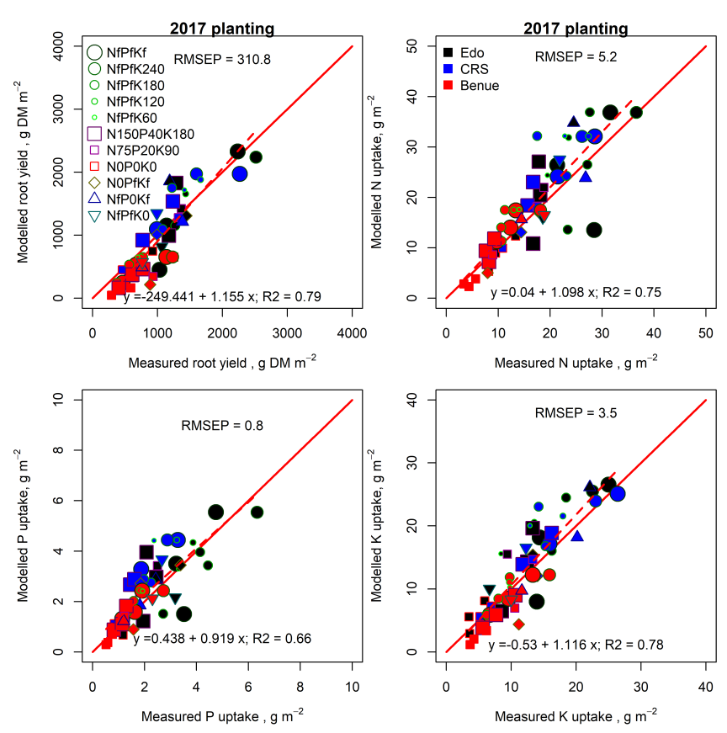
Testing
Joy Adiele, PhD thesis, WU 2020.

Slide 12
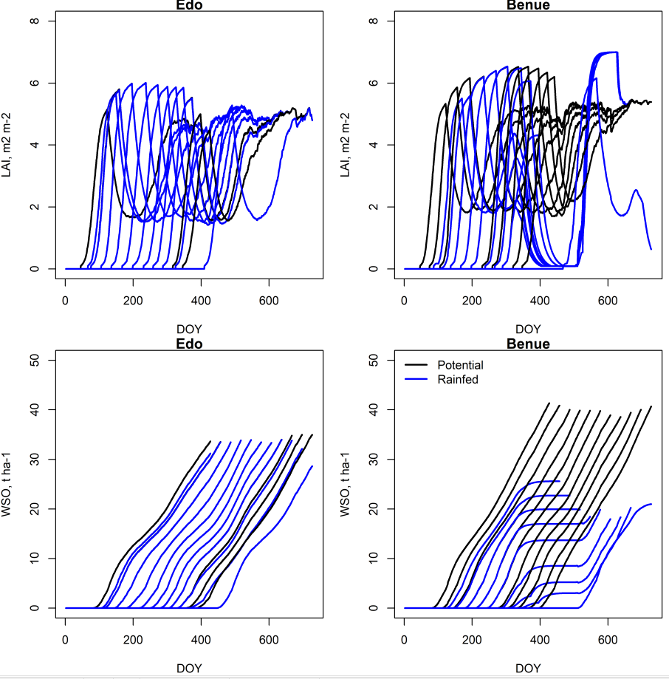
Staggered planting
2016
Monthly planting

Slide 13
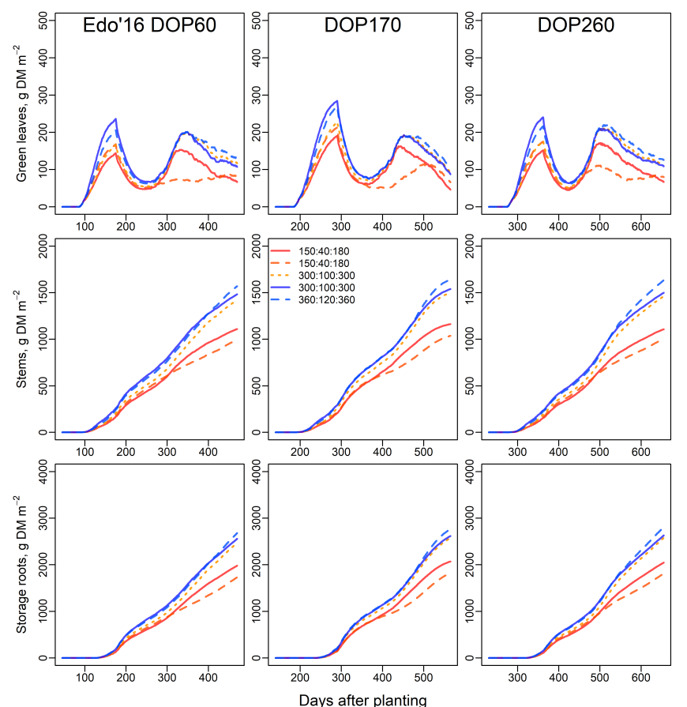
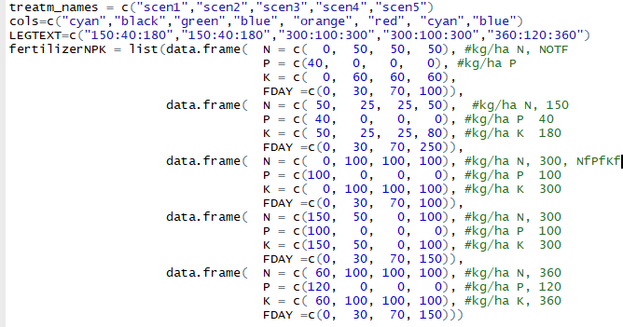
Edo 2016
3 planting dates
5 fertilization scenarios

Slide 14
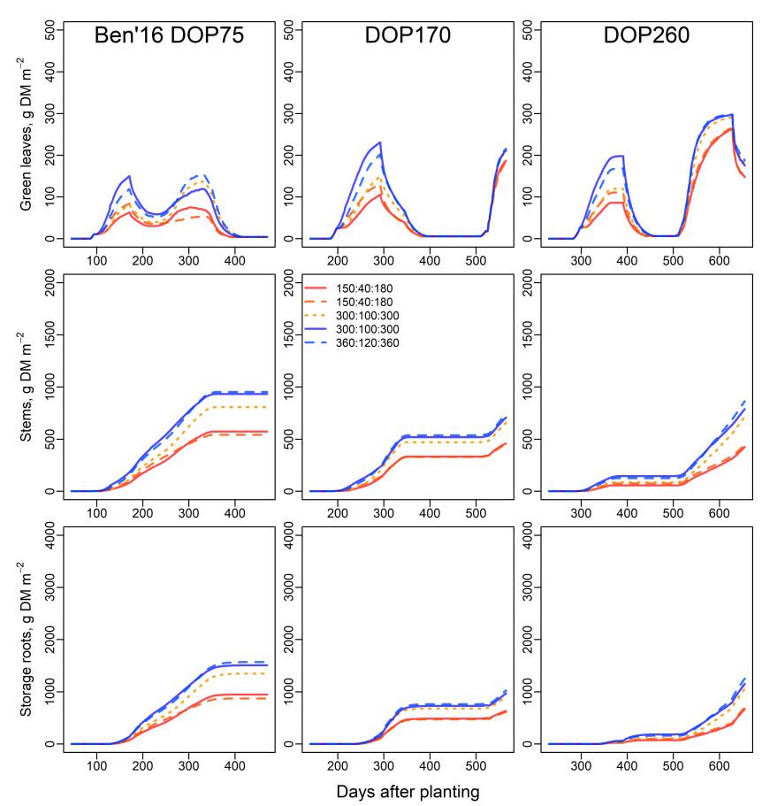
Benue, 2016
3 planting dates
5 fertilization scenarios

